Slide 1

Skills for Success with Microsoft Office 2016 Volume 1
by Margo Chaney Adkins, Catherine Hain, Lisa Hawkins, and Stephanie Murre Wolf
Chapter 1
Common Features
of Office 2016
Notes:
Skills for Success with Microsoft Office 2016 Volume 1

Slide 2
Skills
Start Office Applications
Open and Save Student Data Files
Type and Edit Text
Format Text and Save Files
Apply Themes and Use Mini Toolbar
Notes:
The skills of this chapter are:
Start Office Applications
Open and Save Student Data Files
Type and Edit Text
Format Text and Save Files
Apply Themes and Use Mini Toolbar
The skills continue on the next slide.

Slide 3
Skills (cont.)
Use Backstage View
Insert and Format Images
Format Worksheets
Copy and Paste Objects and Format Slides
Format Access Reports
Notes:
The skills of this chapter are:
Use Backstage View
Insert and Format Images
Format Worksheets
Copy and Paste Objects and Format Slides
Format Access Reports
The skills continue on the next slide.

Slide 4
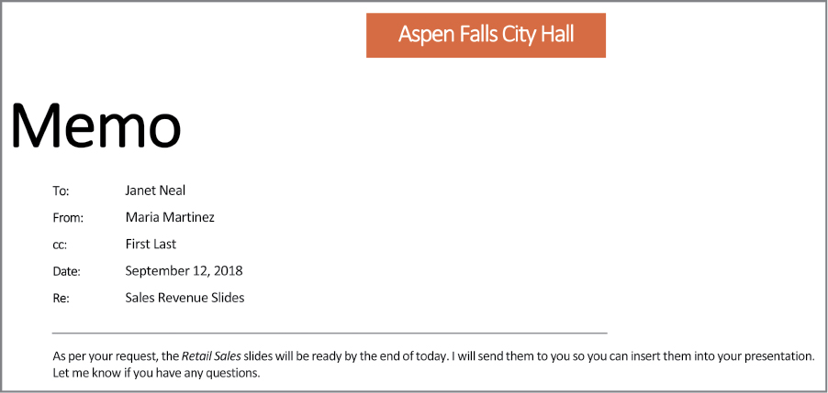
Introduction
Notes:
Using the skills learned in Office 2016, you will be able to work with documents like this text document as well as spreadsheet and presentation applications.

Slide 5
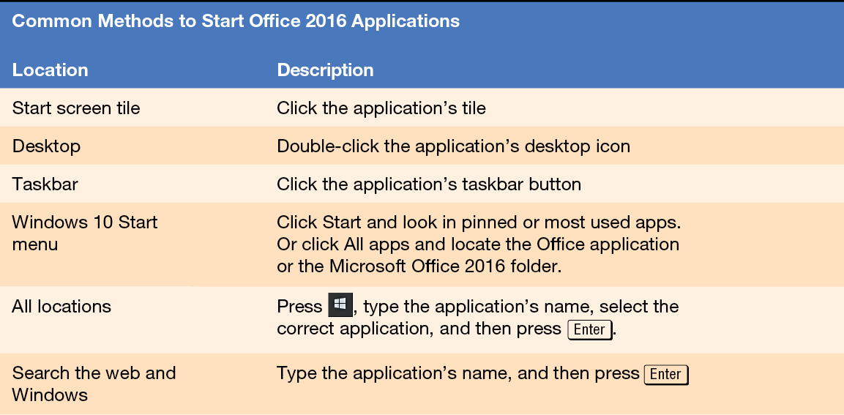
Skill 1: Start Office Applications
Notes:
There are various ways to open an Office application depending on the operating system and how your computer is configured.

Slide 6
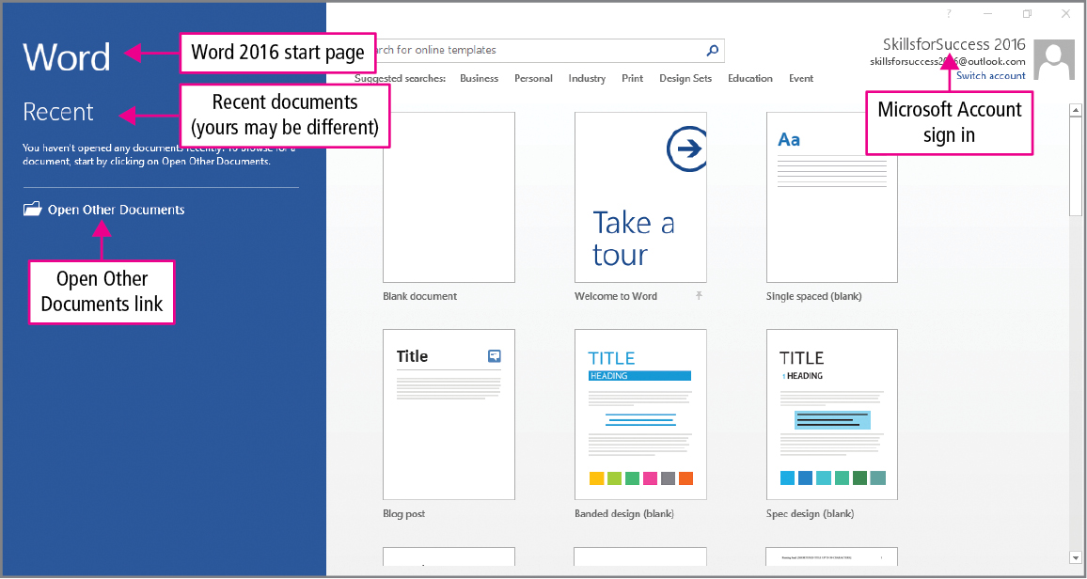
Skill 1: Start Office Applications (cont.)
Notes:
Logging in enables you to access Microsoft cloud services such opening and saving files stored on your OneDrive. To protect your privacy, you should sign in only if you are already signed in to Windows using a unique user name, not a shared account. For example, many public computers share an account for guests.
The list of recent documents will vary depending on what Word documents have been worked with previously. Below the list of recent documents, the Open Other Documents link is used to open Word files that are not listed.

Slide 7
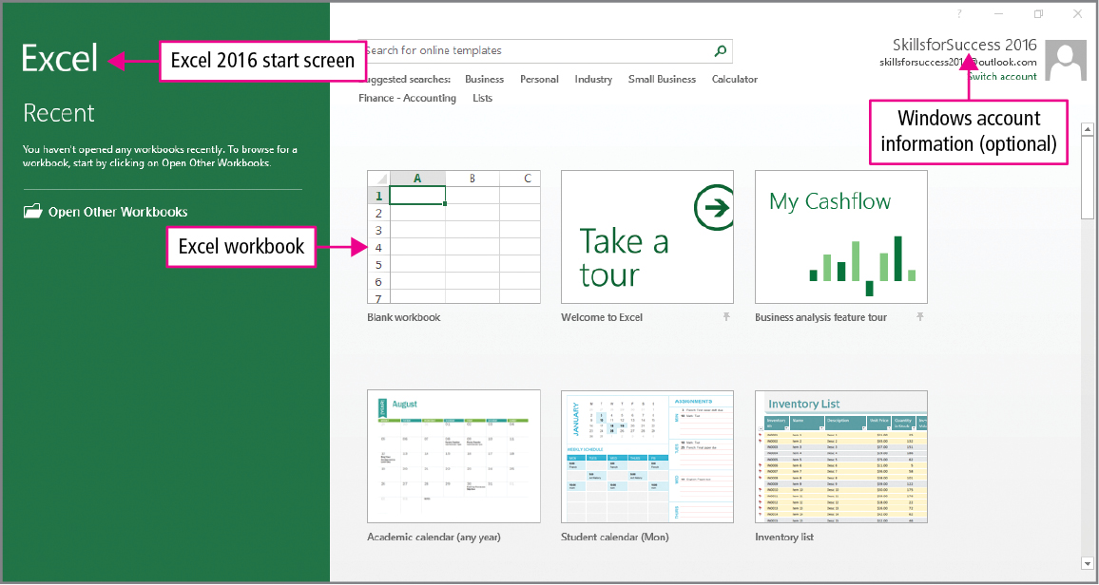
Skill 1: Start Office Applications (cont.)
Notes:
Worksheets are divided into cells, which are boxes formed by the intersection of a row and column into which text, objects, and data can be inserted. In Excel, cells can contain text, formulas, and functions. Worksheets can also display charts based on the values in the cells.
When you are logged in to your Microsoft account, your display name and picture will display in the upper right corner of the window.

Slide 8
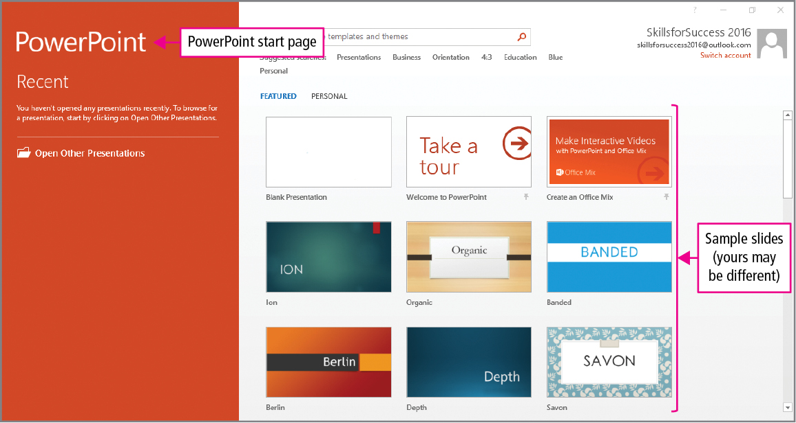
Skill 1: Start Office Applications (cont.)
Notes:
PowerPoint presentations consist of slides, which are individual pages in a presentation that can contain text, pictures, or other objects. PowerPoint slides are designed to be projected as you talk in front of a group of people. The PowerPoint start screen has thumbnails, which are images of several slides formatted in different ways.

Slide 9
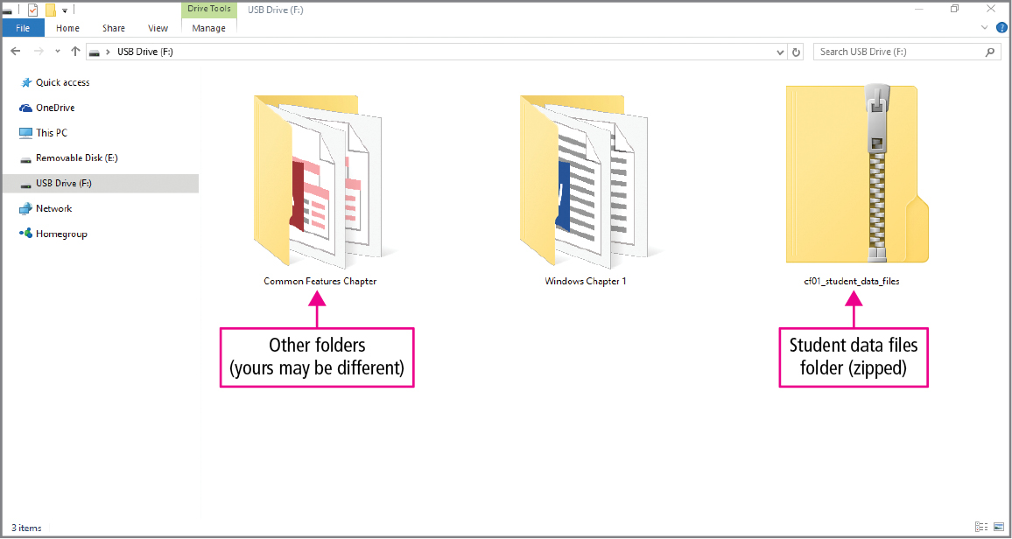
Skill 2: Open and Save Student Data Files
Notes:
Often, file folders need to be downloaded and unzipped or copied. The image of an open file indicates that the file has been unzipped.

Slide 10
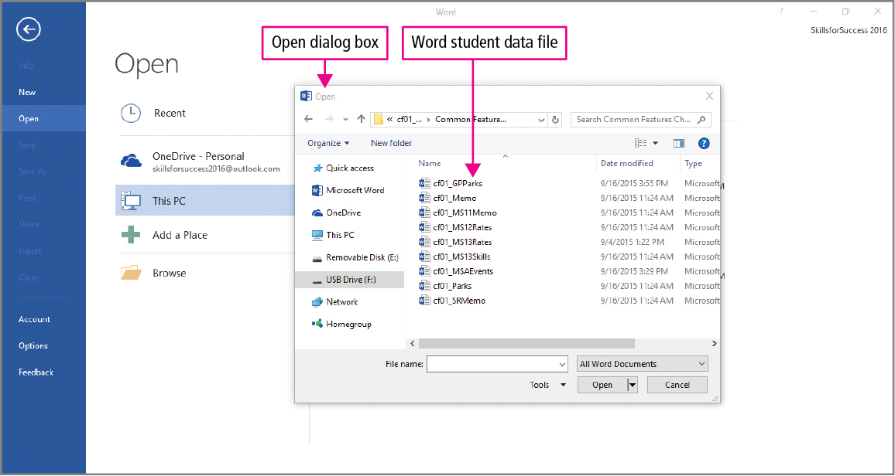
Skill 2: Open and Save Student Data Files (cont.)
Notes:
Documents that are downloaded from websites are usually opened in a Protected View. A Protected View helps users decide if the content is safe before working with the document.

Slide 11
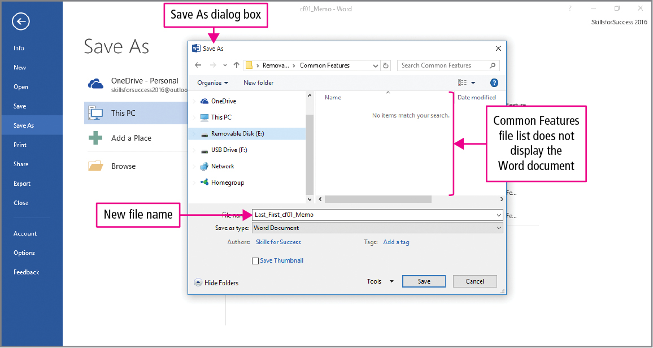
Skill 2: Open and Save Student Data Files (cont.)
Notes:
The Save As command is used to create a copy of a file with a new name. The original data file will remain unchanged.
By default, the Save As dialog box displays only files saved in that application’s file format. Here, the Excel file is listed, but the Word file that was previously saved does not display.

Slide 12
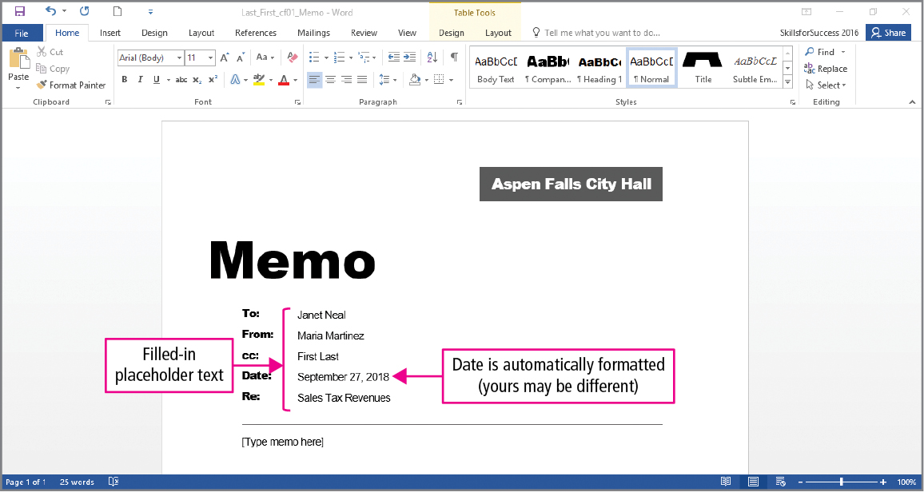
Skill 3: Type and Edit Text
Notes:
New documents are stored in the computer’s temporary memory called RAM until you save them to more permanent storage such as your hard drive, USB flash drive, or online storage.
This memo has a date placeholder. Placeholders are reserved, formatted spaces where text or objects are to be entered. You will edit—insert, delete, or replace text— in the placeholder by positioning the insertion point in the placeholder.

Slide 13
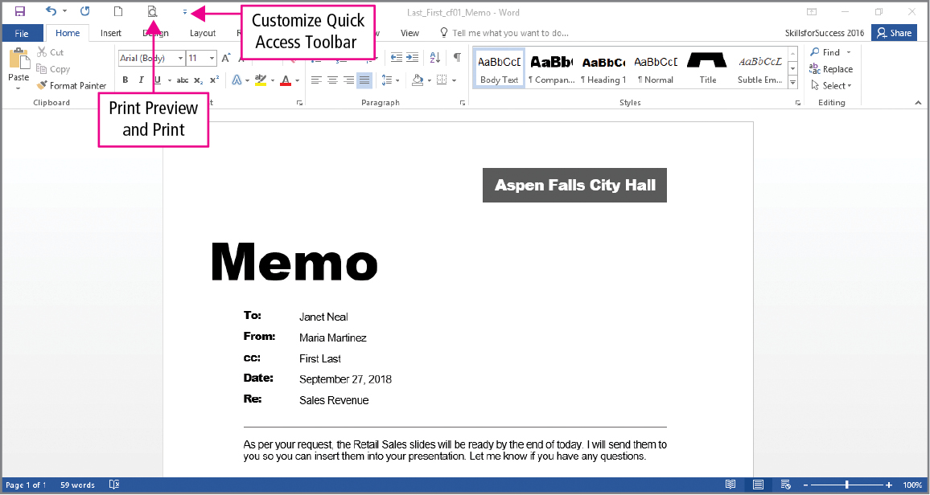
Skill 3: Type and Edit Text (cont.)
Notes:
After selecting text, the Mini toolbar displays near the selection. The Mini toolbar contains common formatting commands.
Text can also be selected by double-clicking or double-tapping the word that you would like to edit.

Slide 14
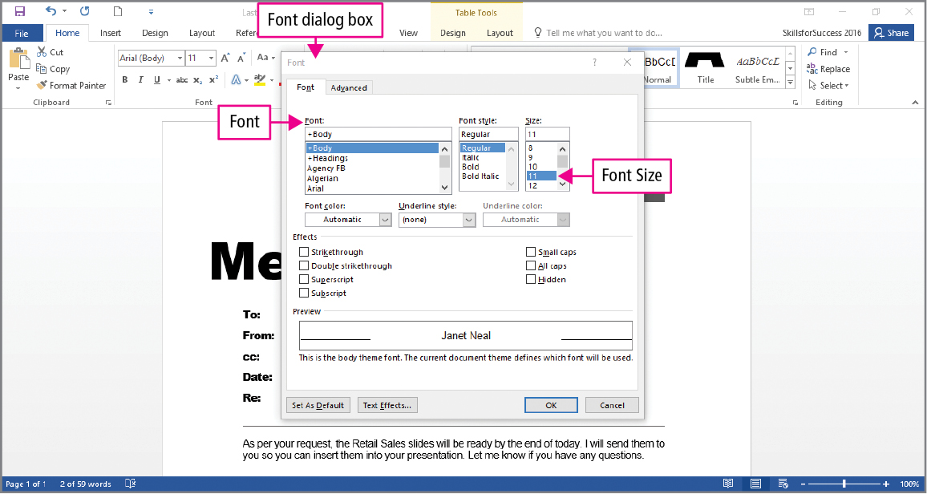
Skill 4: Format Text and Save Files
Notes:
To format is to change the appearance of the text such as changing the text color to red and adjusting the font size.
The Format Painter can be used to easily copy formatting from text that is selected to other text.

Slide 15
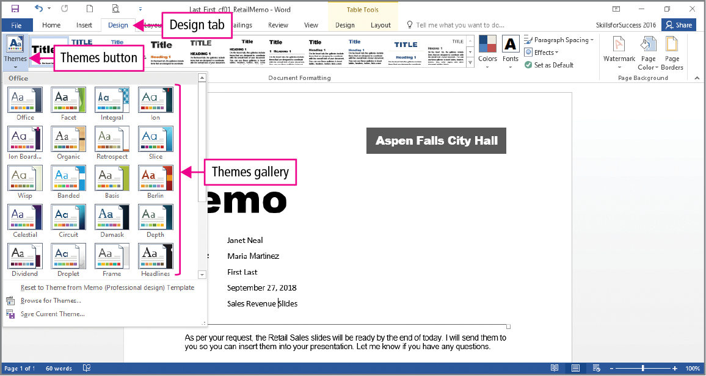
Skill 5: Apply Themes and Use the Mini Toolbar
Notes:
A theme is a pre-built set of unified formatting choices including colors and fonts.
Each theme displays as a thumbnail in a gallery, which is a visual display of choices from which you can choose.
A thumbnail of themes can be previewed using the Preview feature that displays the results of a formatting change if selected.
The different themes, for example, format both headings and body text with specific fonts. A font is a set of characters with the same design and shape. Each theme has two font categories—one for headings and one for body text.

Slide 16
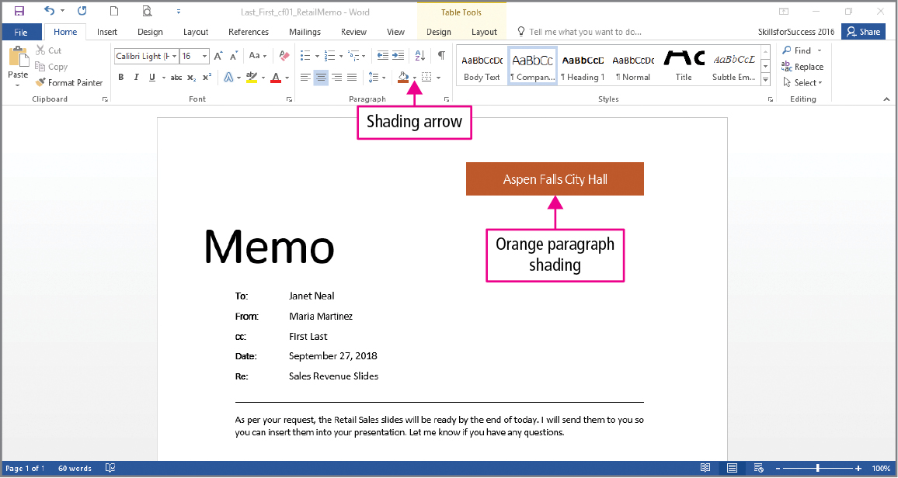
Skill 5: Apply Themes and Use the Mini Toolbar (cont.)
Notes:
In the Paragraph group, clicking the Shading arrow provides options for formatting a paragraph by clicking in the paragraph and using the commands in the drop-down options.

Slide 17
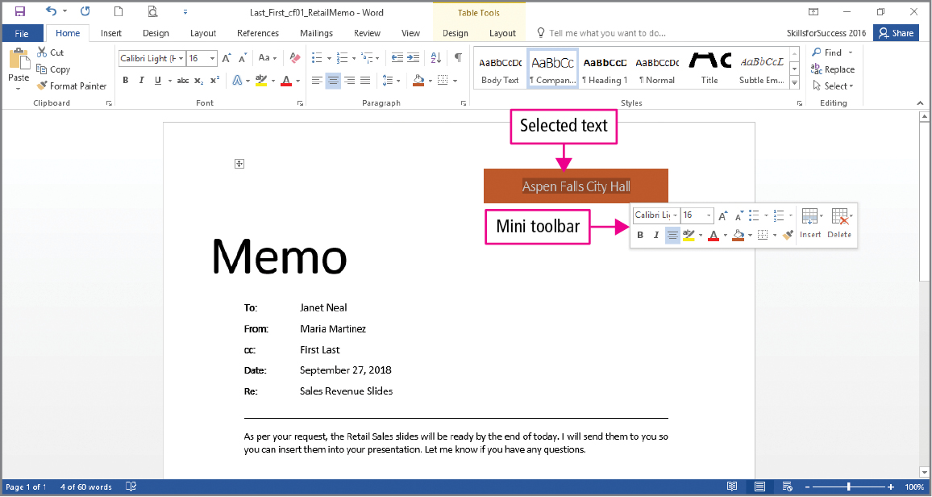
Skill 5: Apply Themes and Use the Mini Toolbar (cont.)
Notes:
Before formatting text, the text must be selected. Text can be selected by using drag, which means to press and hold the left mouse button while moving the mouse.
To select by dragging on a touch display, tap in the text and then drag the selection handle. You can display the Mini toolbar by right-clicking or tapping the selected text.

Slide 18
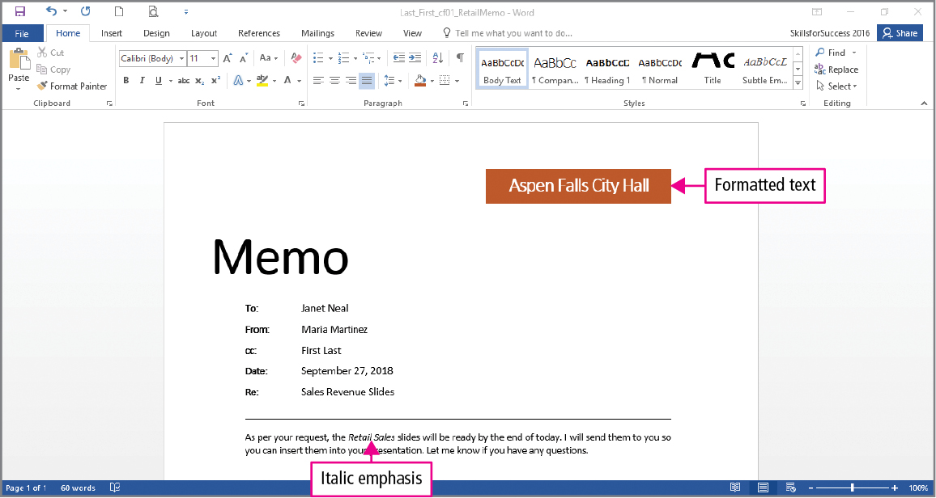
Skill 5: Apply Themes and Use the Mini Toolbar (cont.)
Notes:
You can italicize text by dragging to select the text. From the Mini toolbar, click the Italic button.
Alternately, you can use a keyboard shortcut, which is a combination of keys that performs a command. Pressing Ctrl + I italicizes selected text.

Slide 19
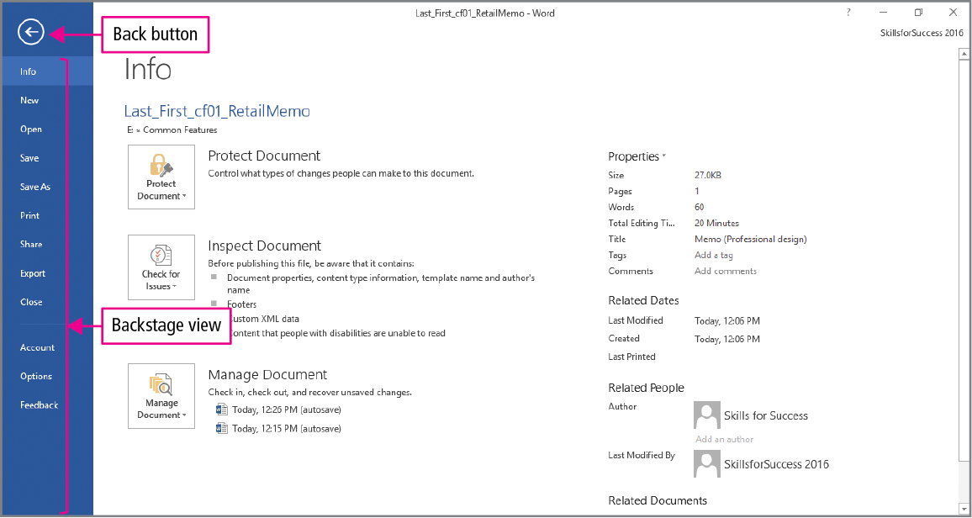
Skill 6: Use Backstage View
Notes:
The Backstage view has pages on the File tab that are used to open, save, print, and perform other file management tasks. Clicking the Back button allows you to return to the open documents.

Slide 20
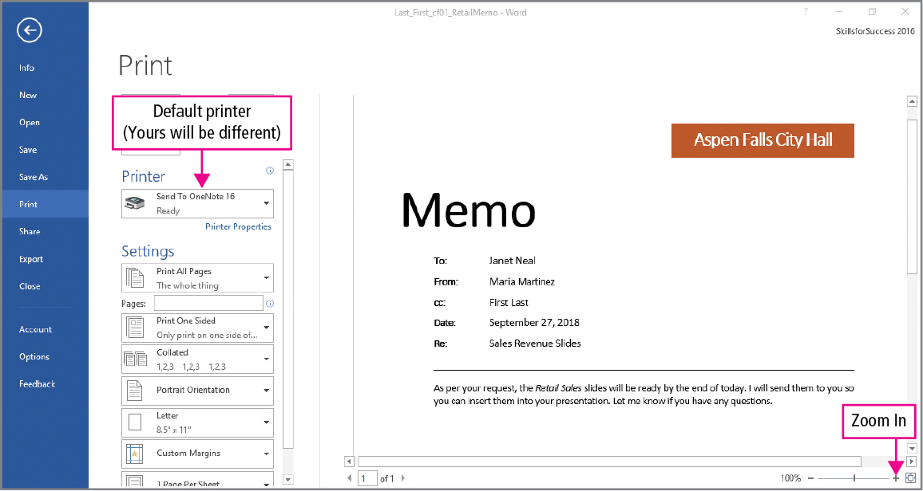
Skill 6: Use Backstage View (cont.)
Notes:
The Printer list displays available printers for your computer along with their status. For example, a printer may be offline because it is not turned on. The default printer is indicated by a check mark and is automatically selected when you do not choose a different printer.
In a school lab or office, it is a good idea to check the list of available printers and verify the correct printer is selected.

Slide 21
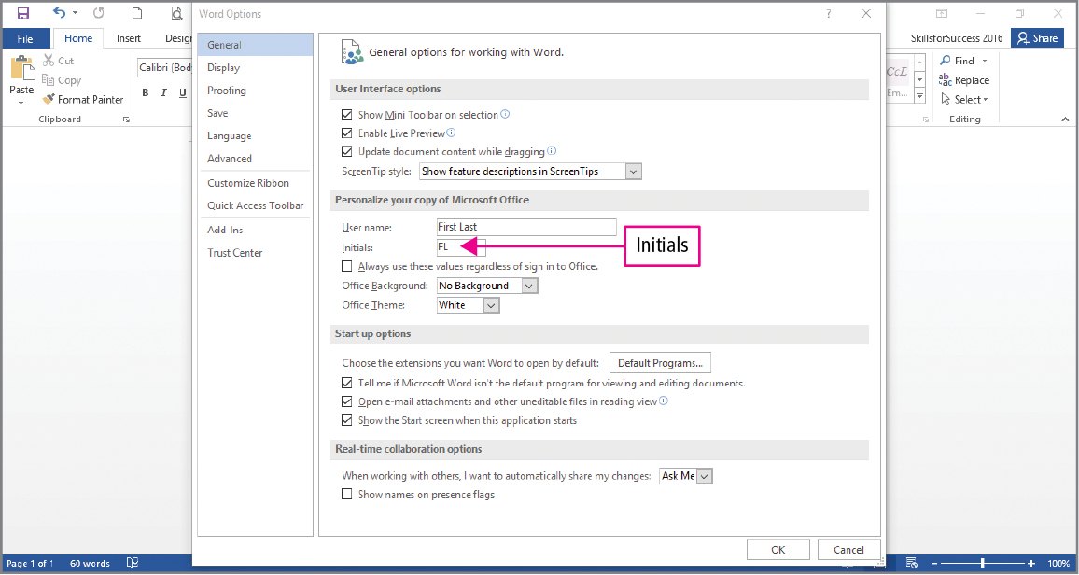
Skill 6: Use Backstage View (cont.)
Notes:
Under Options, you can personalize your copy of Microsoft Office. Here you can add your name, set a default theme and background, change your screen and printing options, add words to a customized dictionary, and much more.

Slide 22
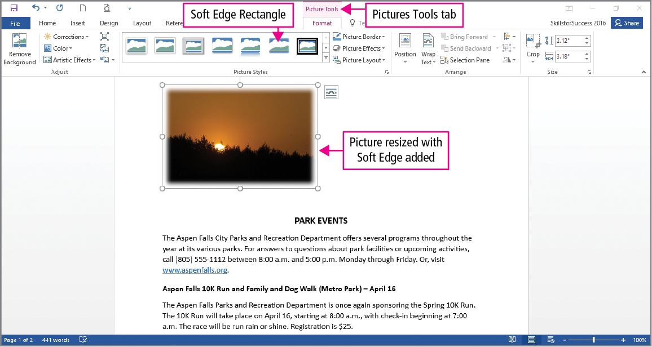
Skill 7: Insert and Format Images
Notes:
Images can be inserted into documents from files or from online resources. They can be resized and rotated, and the color of the picture can be changed. Frames and artistic effects can also be added to images.

Slide 23
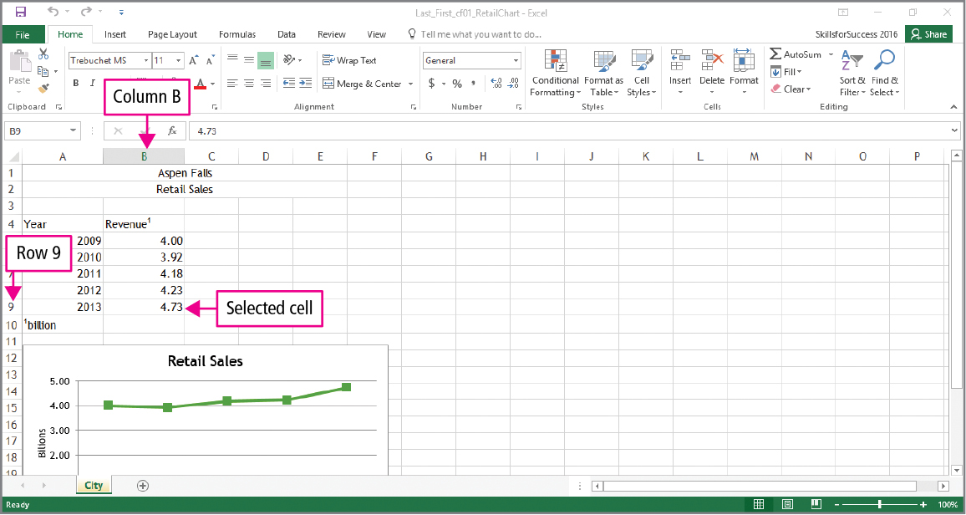
Skill 8: Format Worksheets
Notes:
To keep formatting consistent across all of your Office documents, the same themes are available in Word, Excel, PowerPoint, and Access.
To format text in Excel, you typically select the cell that holds the text and then click the desired formatting command.
A selected slide is indicated by a thick border.

Slide 24
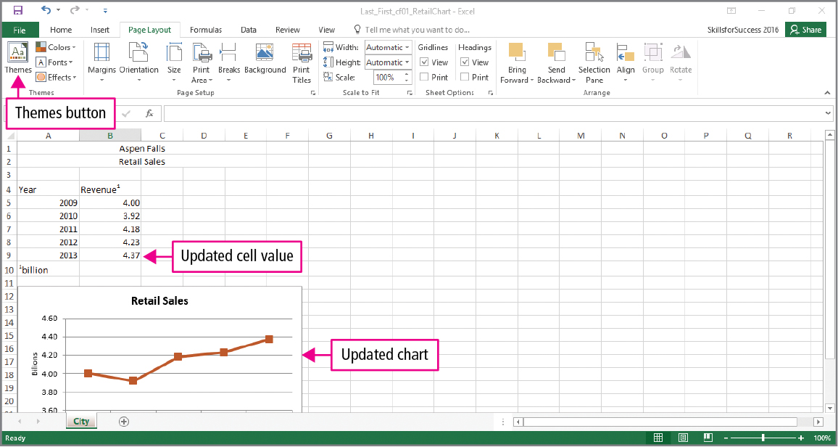
Skill 8: Format Worksheets (cont.)
Notes:
The chart is based on the data in columns A and B. When the data are changed, the chart changes reflecting the new values.
The Themes button applies the same colors, fonts, and effects as the other Office applications. Here, the font is changed and the column width is increased to accommodate the new font.

Slide 25
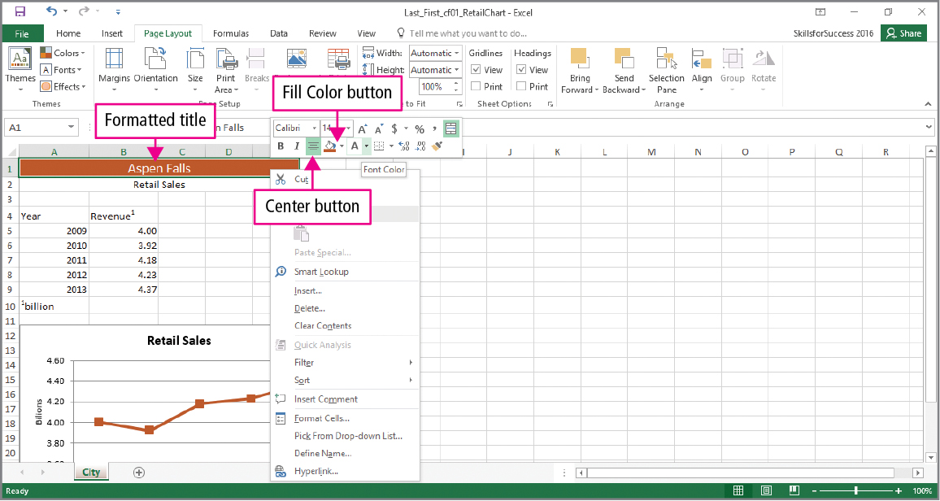
Skill 8: Format Worksheets (cont.)
Notes:
Using the Mini toolbar buttons such as the Fill Color and Font Color buttons, desired font and cell color can be formatted.

Slide 26
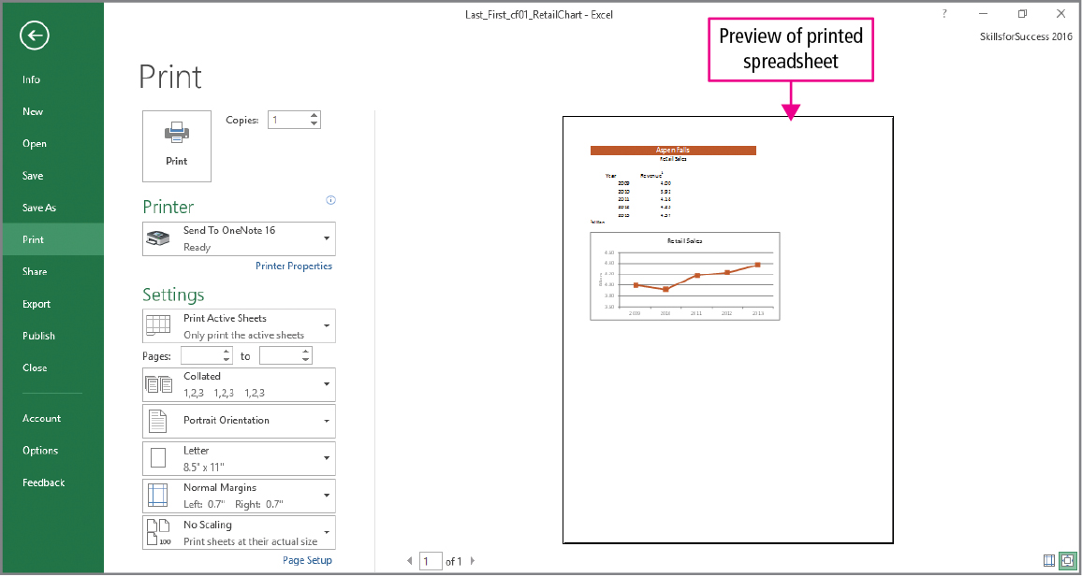
Skill 8: Format Spreadsheets (cont.)
Notes:
The Excel Print page is used in the same way as the Word Print page. You can preview documents, select a printer, and verify that the worksheet will print on a single page. By default, the grid lines do not print.

Slide 27
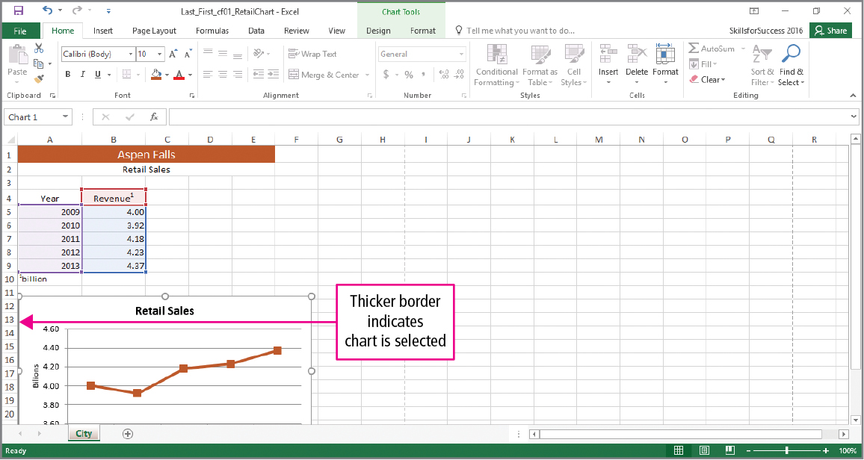
Skill 9: Copy and Paste Objects and Format Slides
Notes:
In Office, certain graphics such as charts and SmartArt display a thick border when they are selected.

Slide 28
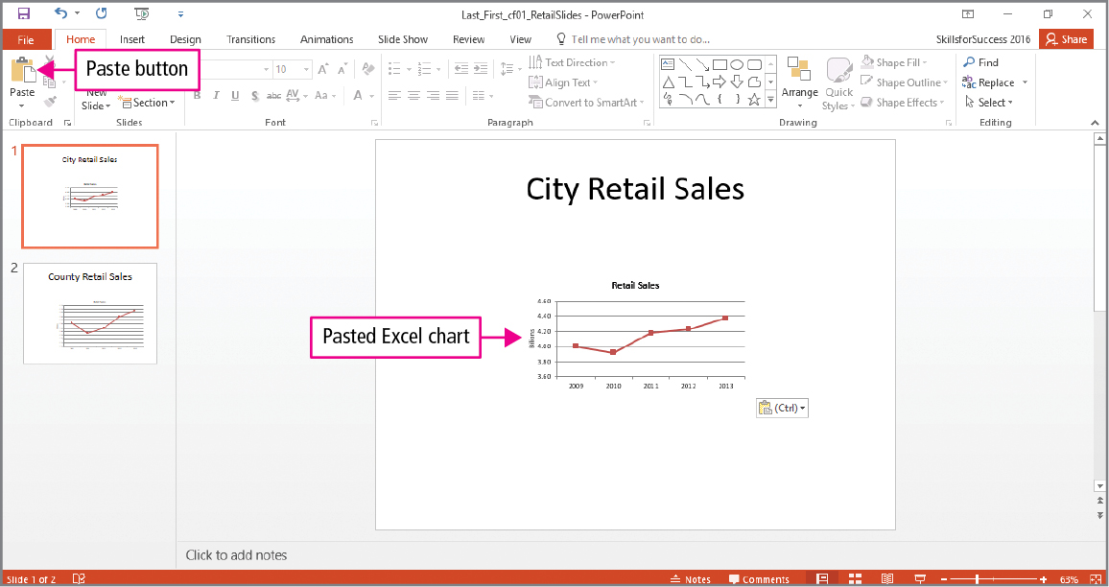
Skill 9: Copy and Paste Objects and Format Slides (cont.)
Notes:
In Office, the copy command places a copy of the selected text or object in the Office clipboard which is a temporary storage area that holds text or an object that has been cut or copied. The paste command inserts a copy of the text or object from the clipboard.

Slide 29
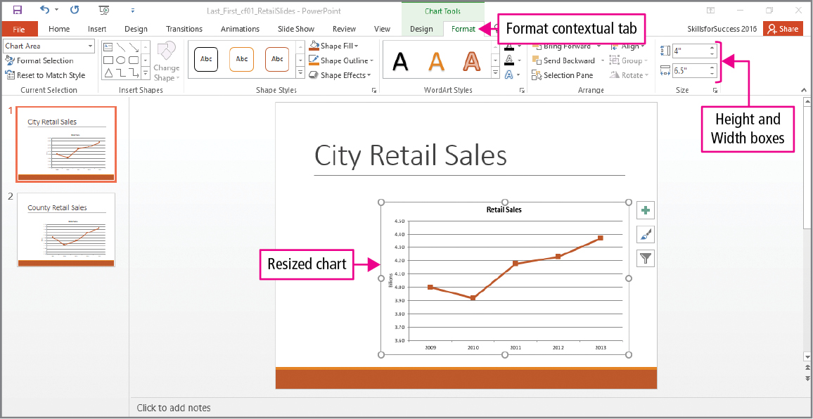
Skill 9: Copy and Paste Objects and Format Slides (cont.)
Notes:
The Format tab is a contextual tab, which is a tab that displays on the Ribbon only when a related object such as a graphic or chart is selected. You can alter the size of selected charts by using the height and width boxes on the Format tab, in the Size Group.

Slide 30
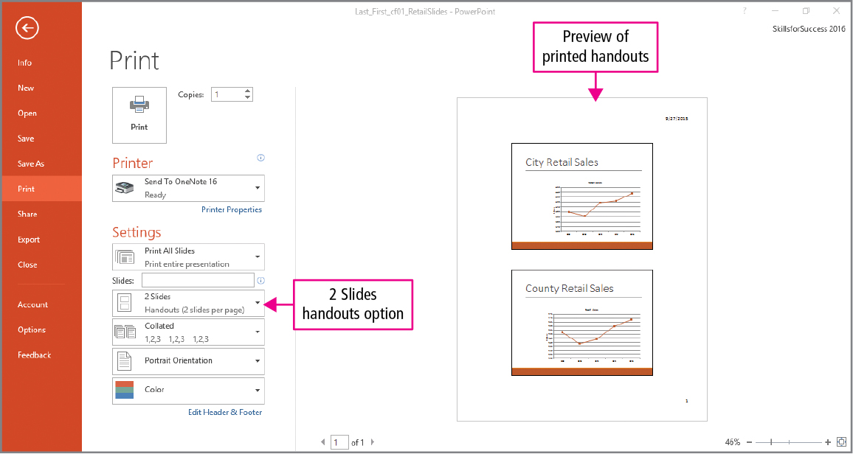
Skill 9: Copy and Paste Objects and Format Slides (cont.)
Notes:
You can alter the print settings to print selected slides, the number of slides per page, portrait or landscape page orientation, and other options on the Print page. A preview of the printed handout is available.

Slide 31
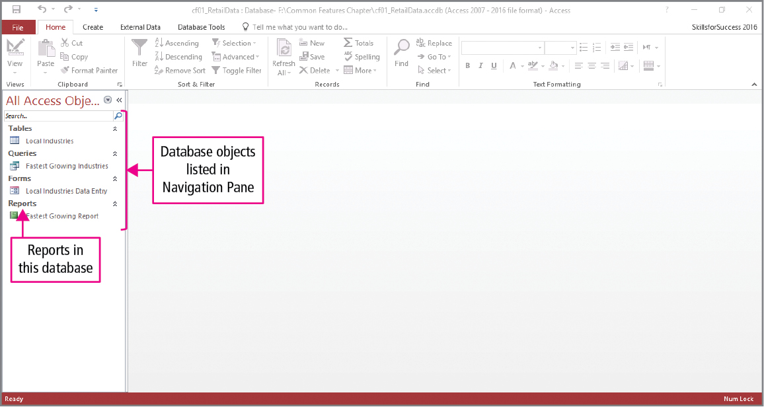
Skill 10: Format Access Reports
Notes:
Access reports present data in a way that is easy for viewing and printing. The yellow security message may display when a database is opened that you did not create. You should click the Enable Content button only when you know the file is from a reliable, trusted source.

Slide 32
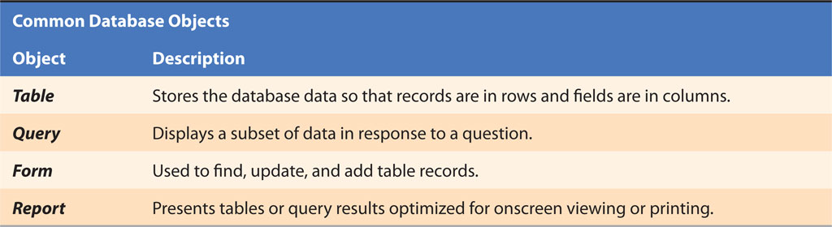
Skill 10: Format Access Reports (cont.)
Notes:
Database files contain several different types of objects such as tables, queries, forms, and reports. Each object has a special purpose.

Slide 33
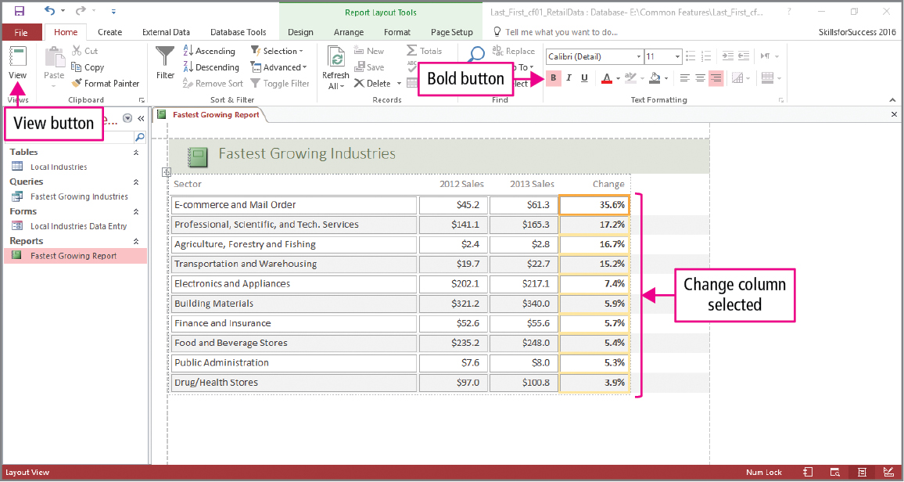
Skill 10: Format Access Reports (cont.)
Notes:
Objects such as reports can be opened and closed without closing the Access application itself.
The View button is used to switch between different views, such as Datasheet, Design, or Layout. As with other Office applications, text formatting is available in the Ribbon containing groups of buttons. Selected columns and cells are highlighted with a bold border.

Slide 34
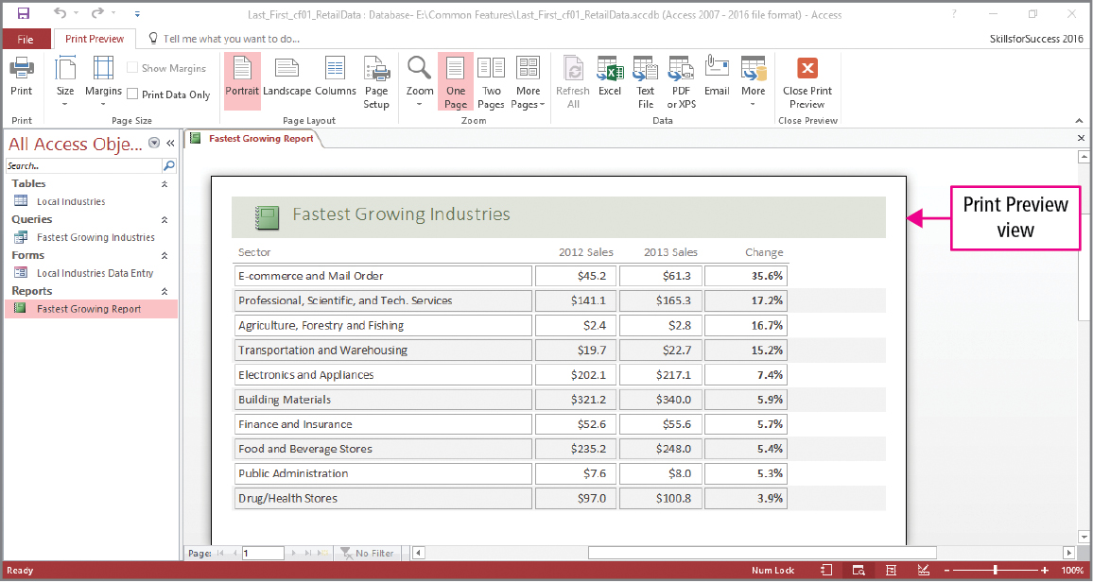
Skill 10: Format Access Reports (cont.)
Notes:
Printing options are available, such as page orientation and number of objects per page. Print preview provides a visual representation of the final document before it is printed.

Slide 35
More Skills For Success
You will now practice the following additional skills:
Store Files Online
Share Office Files
Install Office Add-ins
Customize the Ribbon and Options
Notes:
You will now practice the following additional skills:
Store Files Online
Share Office Files
Install Office Add-ins
Customize the Ribbon and Options

Slide 36
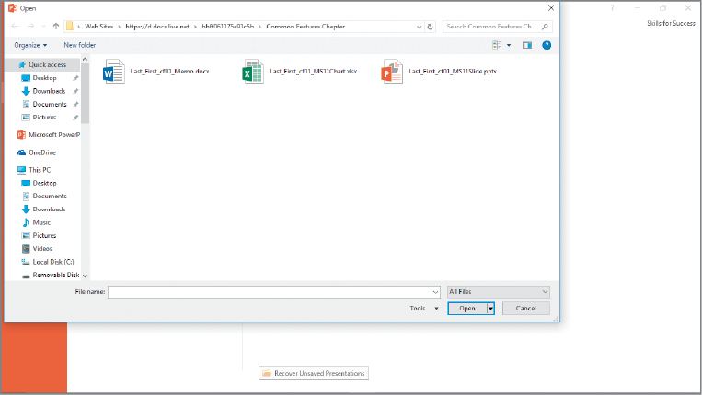
More Skills 11: Store Files Online
Notes:
The Cloud is an Internet technology used to store files and work with programs that are stored in a central location. A Microsoft account is a personal account that is used to access files, settings, and online services from devices connected to the Internet.

Slide 37
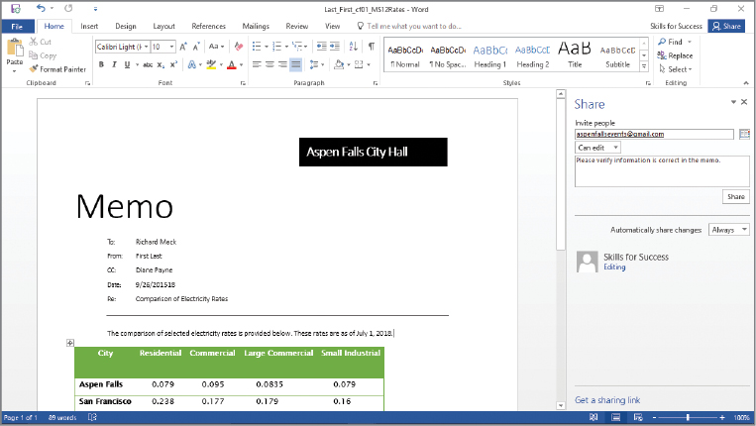
More Skills 12: Share Office Files
Notes:
When working on a team project, you can share files and provide others with either editing or viewing privileges. You can share files instead of sending them as an email attachment.

Slide 38
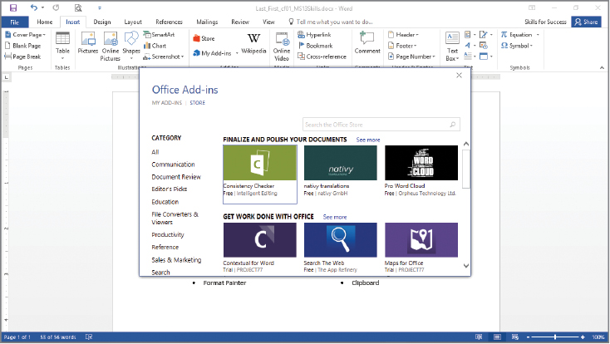
More Skills 13: Install Office Add-ins
Notes:
Office Add-ins are plugins that add extra features or custom commands to Office programs.

Slide 39
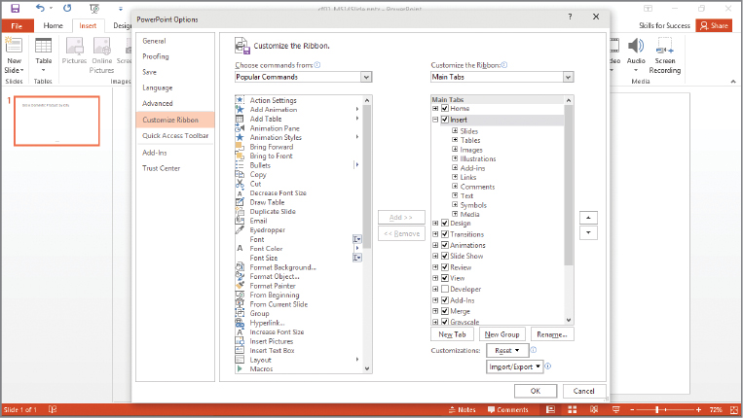
More Skills 14: Customize the Ribbon and Options
Notes:
The Ribbon contains commands organized by tabs and grouped together so that tools can be found quickly. The Ribbon can be customized to meet the users needs.

Slide 40
Questions
Notes:
As you complete this introduction to Common Features of Office 2016, be sure you ask questions. You want to understand the concepts so that you can continue to build on them in future chapters.

Slide 41
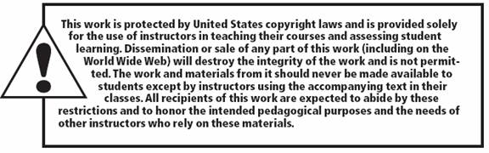
Copyright
All rights reserved. No part of this publication may be reproduced, stored in a retrieval system, or transmitted, in any form or by any means, electronic, mechanical, photocopying, recording, or otherwise, without the prior written permission of the publisher. Printed in the United States of America.

